Slide 1


SATHYABAMA INSTITUTE OF SCIENCE AND TECHNOLOGY​
Project Done By:
R.Suwasthika
43120222
INFORMATION TECHNOLOGY

Slide 2

PROBLEM STATEMENT
Developing a fast, secure, and responsive Nike shoe e-commerce website is challenging due to complex data and user needs.
Managing multiple products, images, and details manually leads to time-consuming updates and inconsistent content.
Traditional web apps face slow loading speeds and poor SEO performance.
Lack of responsive design affects user experience across mobile and desktop devices.
Without proper state management, cart and order updates become unreliable.
Handling secure payments is difficult without a trusted gateway.
Large product images reduce website performance and increase load times.
Deploying and maintaining frontend, backend, and database separately is complex.

Slide 3
OBJECTIVES
To design and develop a modern Nike shoe e-commerce website with an attractive and responsive interface.
To implement Next.js 13 for high performance, fast loading, and SEO-friendly pages.
To use Strapi Headless CMS for efficient product and content management.
To apply Tailwind CSS for quick, mobile-first, and consistent UI design.
To manage cart operations like add, update, and delete using Redux for predictable state handling.
To integrate Stripe for secure and seamless online payment processing.
To use Cloudinary for optimized product image storage and faster media delivery.
To deploy both frontend and backend on Render for easy cloud hosting and maintenance.

Slide 4
SCOPE OF THE PROJECT
To develop a responsive Nike shoe e-commerce website with a modern user interface.
Covers product listing, cart, and secure checkout features.
Next.js 13 used for fast loading and SEO optimization.
Strapi CMS manages product data and content easily.
Tailwind CSS ensures quick and mobile-first design.
Redux maintains reliable cart state management.
Stripe enables secure online payments.
Cloudinary optimizes product images.
Render hosts both frontend and backend on the cloud.

Slide 5

ABSTRACT
Developed an E-commerce platform for Nike Shoes.
Next.js 13 powers frontend with SSR, SSG, and dynamic routing.
Tailwind CSS ensures rapid UI design with mobile-first responsiveness.
Strapi CMS manages product catalog, images (stored in Cloudinary), categories & pricing.
Redux enables complete cart functionality (add, update, delete).
Application is deployed with frontend and backend integration.

Slide 6
INTRODUCTION
The e-commerce industry demands high performance & responsive applications.
Problems in existing systems: slow loading, complex backend, poor scalability.
Proposed Solution: Nike Shoe Website using
Next.js 13 is a React-based framework for building fast, SEO-friendly, and scalable web applications.
It introduces App Router, Server Components, and enhanced data fetching.
Tailwind CSS enables utility-first, mobile-responsive UI development.
Strapi serves as the backend CMS, managing content and APIs.
Redux manages application state, ensuring predictable updates.
The integration of these tools provides a complete full-stack development ecosystem.
Stripe: Enables secure checkout and payments.
Cloudinary: Optimizes product images.
Render: Cloud hosting for both frontend & backend.

Slide 7

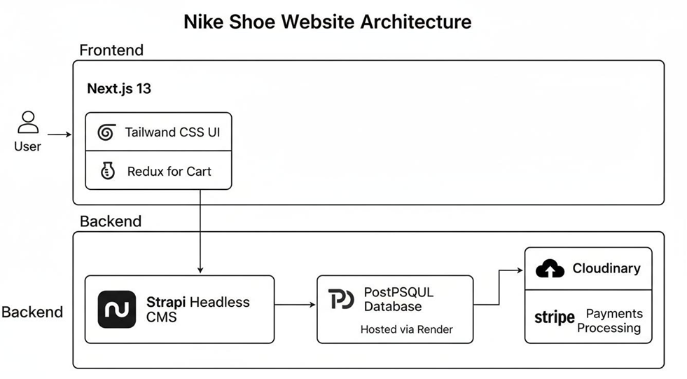
ARCHITECTURE OF THE PROPOSED SYSTEM

Slide 8

METHODOLOGY
Requirement Analysis: Identified key features such as product catalog, cart, payment, and image management.
Design Phase: Created responsive UI layout using Tailwind CSS and user flow diagrams.
Frontend Development: Built using Next.js 13 for fast rendering (SSR/SSG) and smooth navigation.
Backend Development: Configured Strapi CMS for managing product data and API creation.
State Management: Implemented Redux for cart operations (add, update, delete).
Payment Integration: Integrated Stripe API for secure and easy checkout.
Image Management: Used Cloudinary for optimized and fast-loading product images.

Slide 9

MODULE EXPLANATIONS
User Interface Module: Developed using Next.js 13 and Tailwind CSS for fast, responsive, and SEO-friendly design.
Content Management Module: Strapi CMS used to manage Nike shoe data, categories, and descriptions easily.
State Management Module: Redux handles cart operations like add, update, and delete for smooth user experience.
Payment Module: Integrated Stripe for secure and seamless online payment and order confirmation.
Image Optimization Module: Cloudinary stores and optimizes product images for faster page loading.
Deployment Module: Render hosts both frontend and backend, providing reliable cloud deployment and scalability.

Slide 10
OUTPUT
HOMEPAGE

Slide 11
PRODUCT DETAIL PAGE

Slide 12
SHOPPING CART

Slide 13
STRIPE CHECKOUT PAGE

Slide 14
SUCCESSFUL PAYMENT CONFIRMATION PAGE

Slide 15
RESULT
A fully functional Nike shoe e-commerce website was successfully developed.
The site provides a smooth user experience with responsive design using Tailwind CSS.
Next.js 13 improved website speed, SEO performance, and server-side rendering.
Strapi CMS enabled easy product and content management for admins.
Redux ensured stable cart operations and real-time updates.
Stripe integration allowed secure and efficient online payments.
Cloudinary optimized images, enhancing loading speed and visual quality.
Render deployment made the project scalable and accessible online.

Slide 16
CONCLUSION
The project successfully developed a modern Nike shoe e-commerce platform using Next.js 13 and Strapi CMS.
It achieved fast performance, secure payments, and mobile-first responsiveness.
Redux simplified cart management and improved user interactivity.
Stripe ensured a reliable and secure checkout process.
Cloudinary enhanced website efficiency with optimized images.
Render provided seamless cloud deployment for both frontend and backend.
Overall, the system delivers a scalable, efficient, and user-friendly shopping experience.

Slide 17
REFERENCES
Next.js Team. (2024). Next.js – The React framework for production. Vercel. https://nextjs.org/docs
Tailwind Labs Inc. (2024). Tailwind CSS – Rapidly build modern websites without ever leaving your HTML. https://tailwindcss.com/docs
Strapi Solutions. (2024). Strapi – The leading open-source headless CMS. https://strapi.io/documentation
Redux Team. (2024). Redux Toolkit – Efficient Redux development for modern apps. https://redux-toolkit.js.org
Stripe Inc. (2024). Stripe API – Online payments, built for developers. https://stripe.com/docs/api

